Slide 1
2025 COMMUNICATIONS BUDGET OVERVIEW November 14, 2024 Tanya Y. Jackson, Public Information Officer

Slide 2
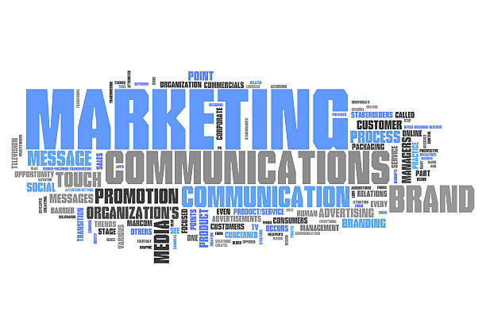
Strategic Plan – Tapping into the P.O.W.E.R. of Willingboro WELL-CONNECTED, EDUCATED COMMUNITY

Slide 3
Our Goal: Offer more opportunities for the Willingboro community to connect or feel connected.
Ensure that new residents feel welcomed, informed, and equipped with the information they need.
Expand opportunities via our social media platforms, website, Gov Delivery services., etc. Use all modes of communication to the best of our ability to keep residents informed –Social Media, E-Newsletter, Digital Bulletin Boards, Comcast Public Access Channel, Live and Recorded Videos, Podcast/Door Hangers, Lawn Signs, Banners, U.S. Mail (where financially feasible) etc.
Increase our subscriber base for Willingboro Weekly and Willingboro Connect by 10%.
Enhance communications by utilizing videos, podcast and more live broadcasts to increase community engagement.
Increase the opportunity to ensure more residents have access to the Township.
Ensure every resident is well informed about Township events, activities, updates, etc.

Slide 4
2025 Communications Budget Request $96,000
-Granicus/Subscription Services - $26,000
-Township Marketing and Promotional Services - $10,000 -Community Mailings (Calendar & 2 mailings) - $40,000
-Vendor Services/Supplies/Training - $5,000
-Community Engagement Events – Podcasts, Etc. – $10,000
-MISC Support/ Services - $5,000

Slide 5
The Communications Department is positioned to do our part to inspire and nurture a welcoming and inclusive community that encourages and embodies engagement, collaboration, and equity. THANK YOU!

